Slide 1

Delivery App
Project of PM

Slide 2
Outline :
The main points in
Project Charter
Project Scope
Work Breakdown Structure (WBS)
WBS Dictionary
Responsibility Matrix
Project Network
Resource Constrained
Budget Baseline

Slide 3
1) THE Project charter
The Project goals is
take a consumer's order and send it to the seller through a completely automated process, so the consumer doesn't have to deal with all the hassles of ordering and we make sure you receive your order on time, every time!
create an easy way to deliver customers' things in an easy and safe way
provide job opportunities

Slide 4
THE Project charter
Business cases
It works in all cases and increases in cases where customers do not want to move their things themselves because of the weather or the difficulty of transportation
key deliverables
The first strategy for success is to focus on
customer satisfaction
deliver products safely to customers.

Slide 5
THE Project charter
General statement
Customers will contact the staff to make an order through a mobile application or customer service.
Resources Required
Transportation from cars, bicycles
good packing materials.
quality manager,
reception staff
delivery workers
4 - Data Scientist
7 - Front-end Developer
15- Backend Developer
5 - Mobile Developer
6 - Network Engineer

Slide 6
Budget
From 1 Million $ to 5 Million$
Risks
A defect in the information related to the goods.
Loss of a customer's merchandise.
Delayed delivery
Commercial lines malfunction

Slide 7
The Project Scope
Project scope description
Includes the requests required by the project, such as equipment and techniques that assist tasks within the project such as
Product acceptance criteria
Effective and reliable mechanisms for targeting audiences and customers,
robust marketing schemes that contribute to enterprise proliferation and competitiveness
Simple to use app
Performance and speed of the application
Easy to browse and search

Slide 8
The Project Scope
project deliverables
- the application
- the trade name
- the company’s marketing plan

Slide 9
The Project Scope
Project Assumptions
The company's database may fail and we lose all the information of the goods and customers and this will lead to a great risk and there must be a copy of the company's information to avoid this risk.
Goods may be lost and must be insured so a Delivery Driver Reviewing orders before and after delivery
Project Constraints
5 million-dollar budget will be your project constraint, and you have to complete the project under this budget

Slide 10
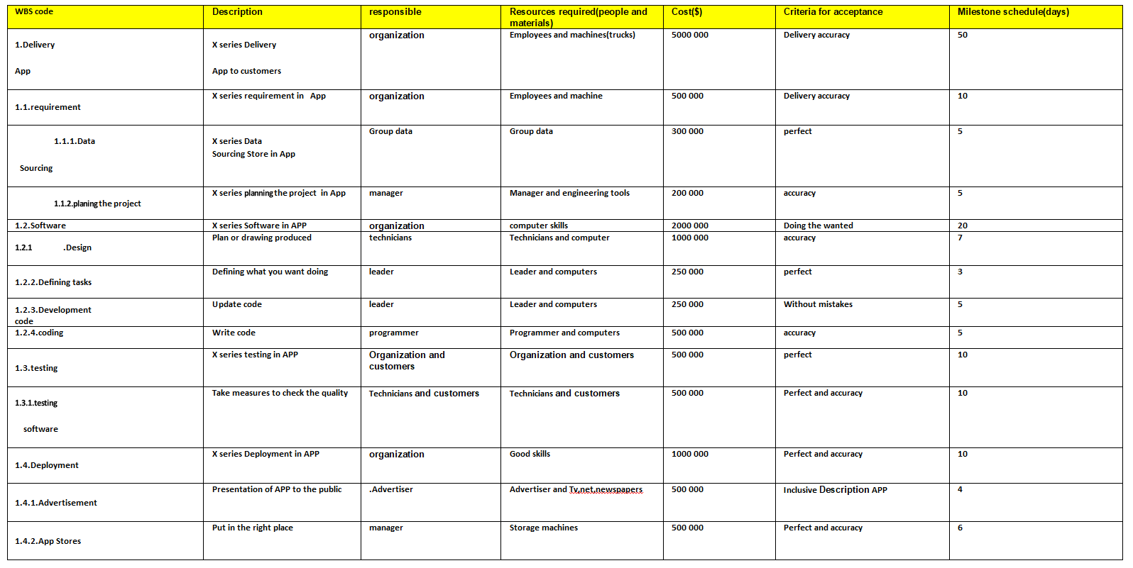
Wbs and wbs dictionary

Slide 11
***Creating a WBS Dictionary***
1.Code of accounts number : is a numbering system that shows the different levels of WBS components and identifies which components belong to which parts of the WBS
in project( Delivery App):1...requirement( .Data Sourcing _planing the project)
2.Software(Design _Defining tasks_.Development code _coding)
3.testing(.testing software ) 4.Deployment(Advertisement_App Stores)
2.Description of the WBS element :Describes his whole step in project( Delivery App )
*requirement :series requirement in App from planing the project and Data Sourcing
*Software:Plan or drawing produced and Write code
*.testing:Take measures to check the quality
*Deployment:Presentation of APP to the public and Put in the right place

Slide 12
***Creating a WBS Dictionary***
3.Person, or other organization responsible for the WBS element :
*requirement :Group data and manager
*Software:leader,programmer,Technicians and Designer
*.testing:Technicians and customers
*Deployment:manager and Advertiser
4.Resources required to create the WBS element (resources are people, materials, and facilities) :*requirement :Group data,Employees and machine
*Software:computer skills,Technicians and computer
*.testing:Technicians and customers
*Deployment:Good skills,Advertiser ,Tv,net and newspapers,Storage machines

Slide 13
***Creating a WBS Dictionary***
5.Cost to create the WBS element($) :requirement(500 000)_Software(2000 000)_testing(500 000)_Deployment(1000 000)
6.Criteria for acceptance of the specific deliverable
*requirement :Delivery accuracy and perfect
*Software: Delivery accuracy ,Doing the required and perfect
*.testing:Perfect and accuracy
*Deployment:Inclusive Description APP and accuracy
7.Milestone schedule(weeks)
requirement(10)_Software(20)_testing(10)_Deployment(10)

Slide 14
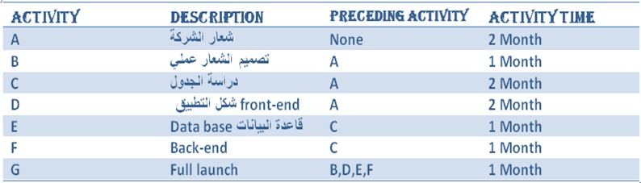
Network and resources

Slide 15
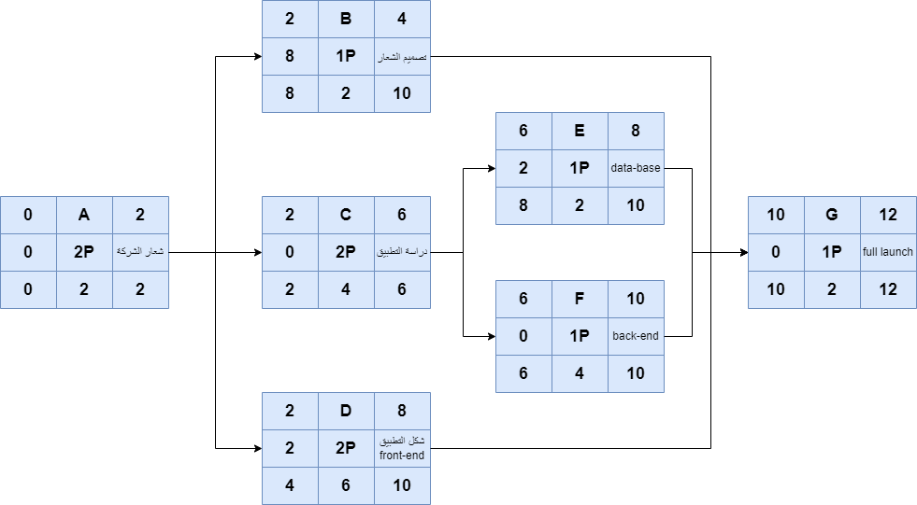
The project network is developed from the information collected for the WBS and is a graphic flow chart of the project job plan. The network show the project activities that must be completed, the logical sequences, the interdependencies of the activities to be completed, and in most cases the times for the activities to start and finish along with the longest path(s) through the network—the critical path.

Slide 16
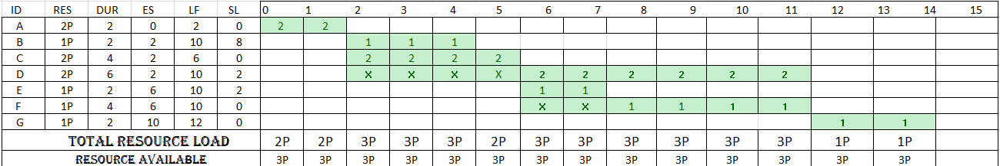
The table shows the work of the tasks in the schedule, with the resources of each task and the resources identified for each project

Slide 17
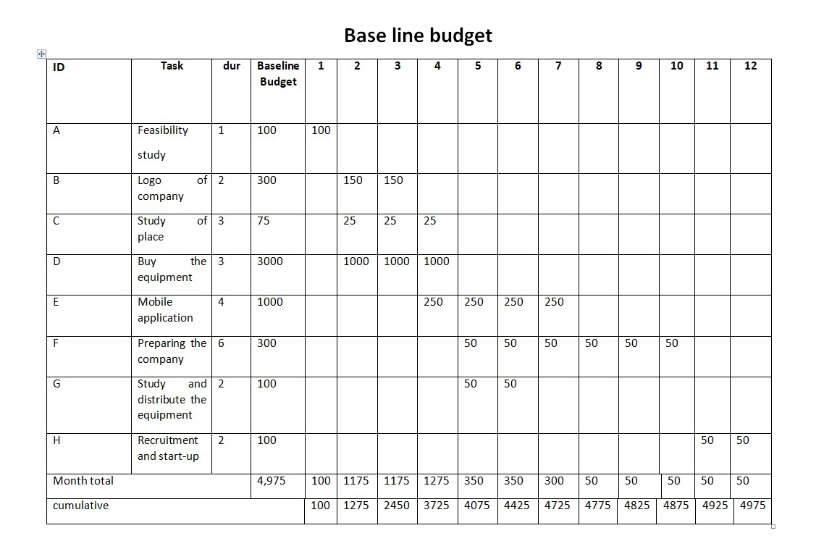
Base line budget

